Slide 1
Westward Expansion
1860-1890

Slide 2
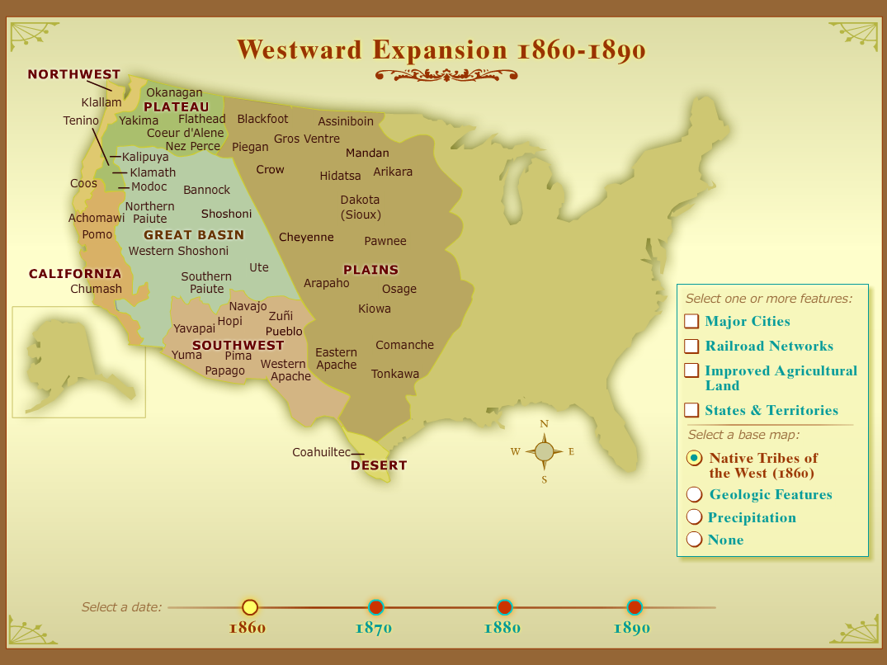
Native Tribes of the West (1860)

Slide 3
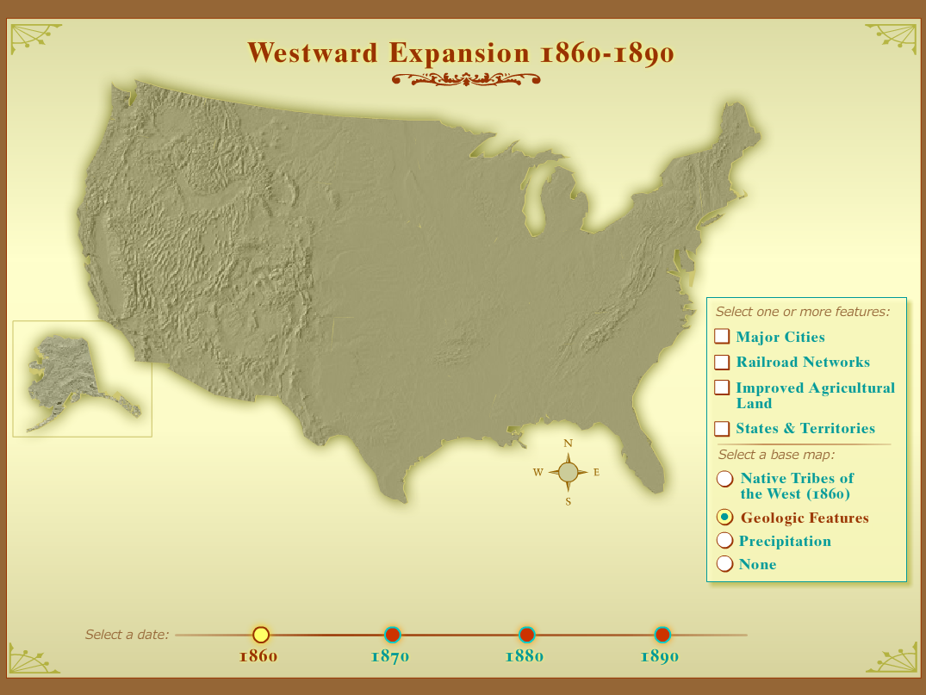
Geologic Features

Slide 4
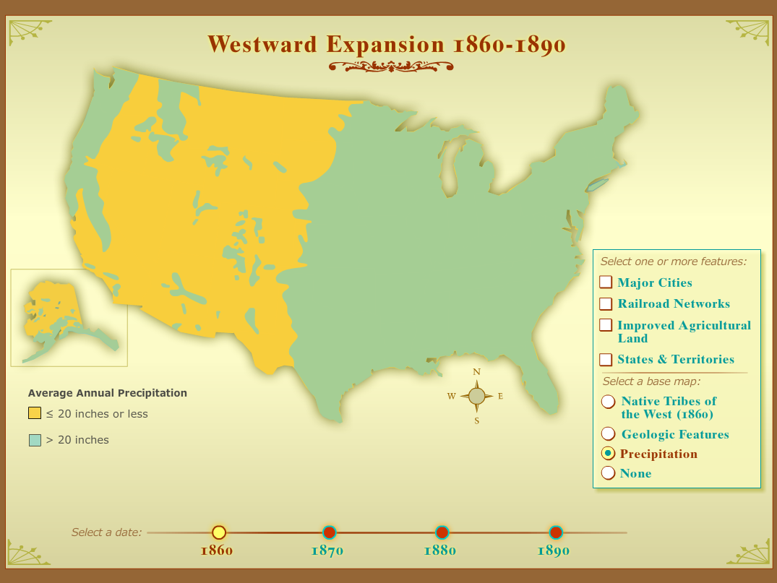
Precipitation Map

Slide 5
States and Territories
1860-1890 in ten-year intervals

Slide 6
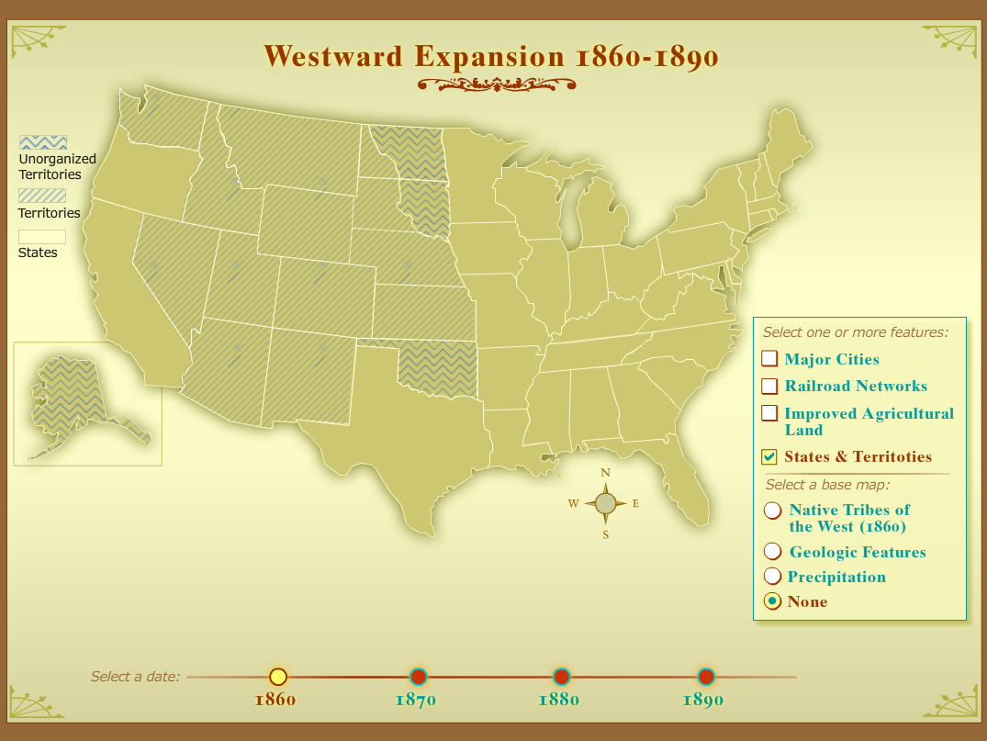
States and Territories - 1860

Slide 7

States and Territories - 1870

Slide 8
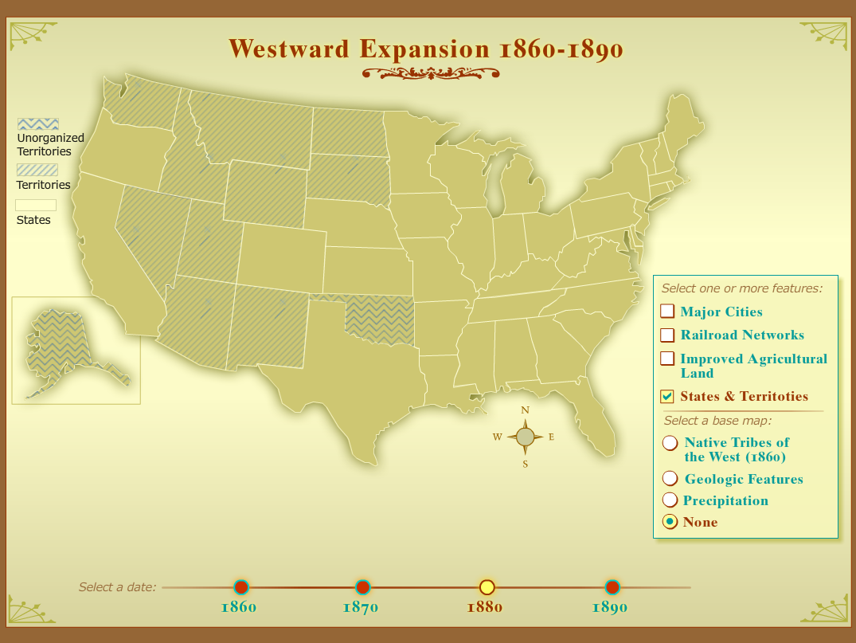
States and Territories - 1880

Slide 9

States and Territories - 1890

Slide 10
Major Cities and Railroads
1860-1890 in ten-year intervals

Slide 11
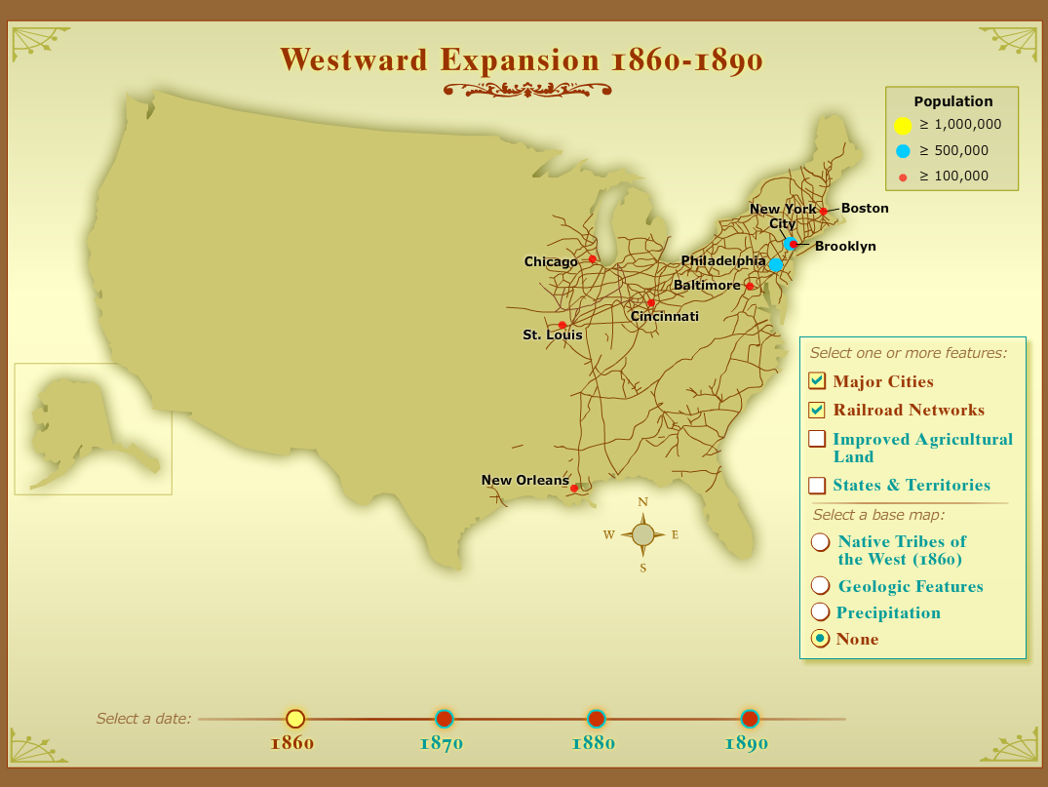
Major Cities and Railroads - 1860

Slide 12

Major Cities and Railroads - 1870

Slide 13
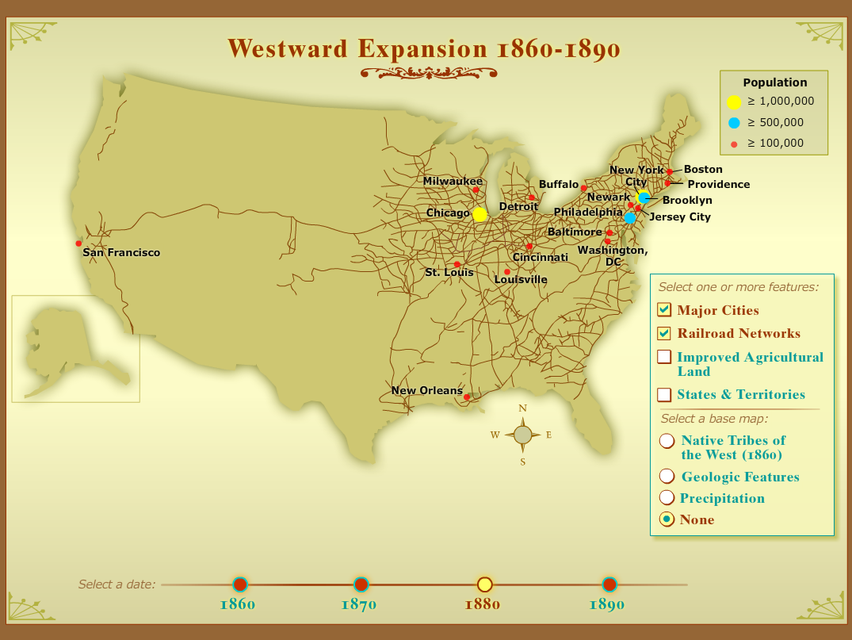
Major Cities and Railroads - 1880

Slide 14
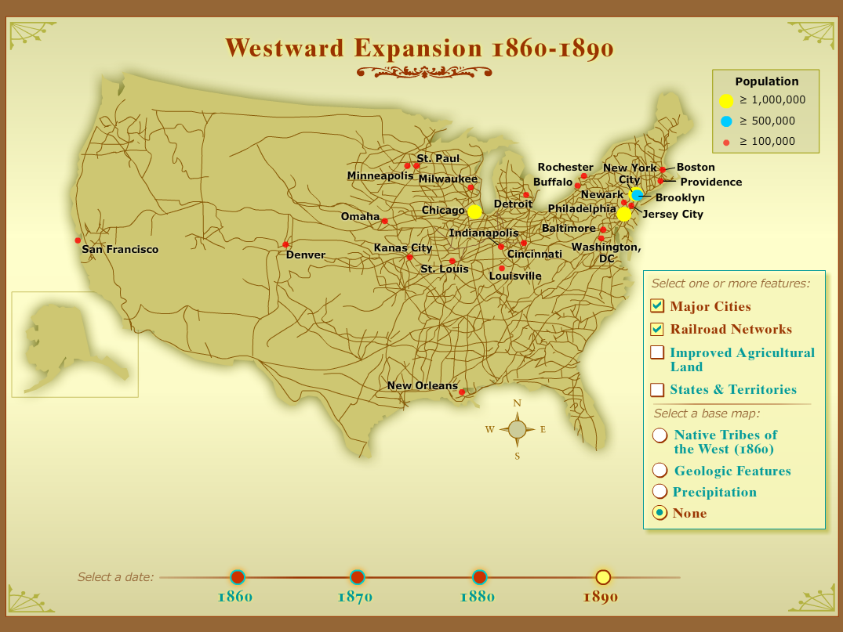
Major Cities and Railroads - 1890

Slide 15
Improved Agricultural Land
1860-1890 in ten-year intervals

Slide 16
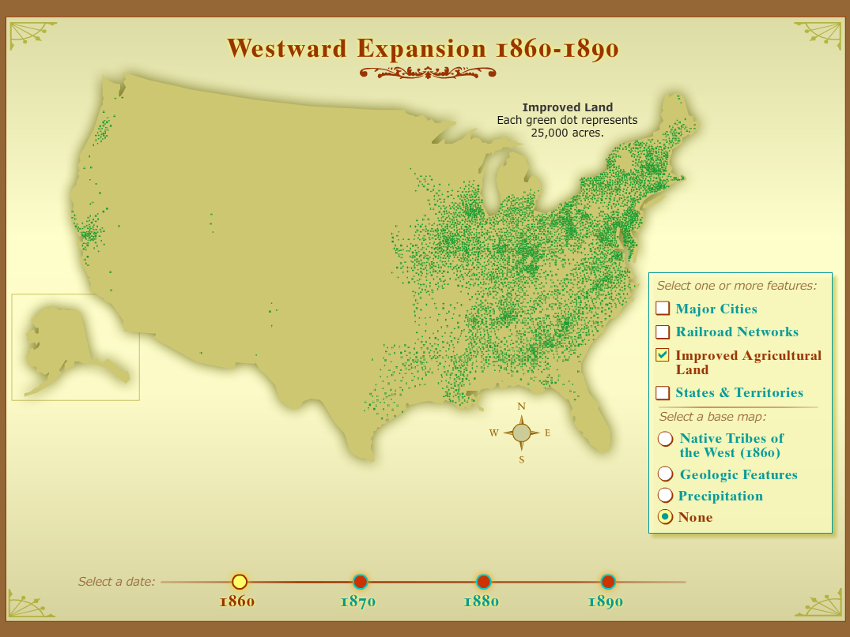
Agricultural Land - 1860

Slide 17
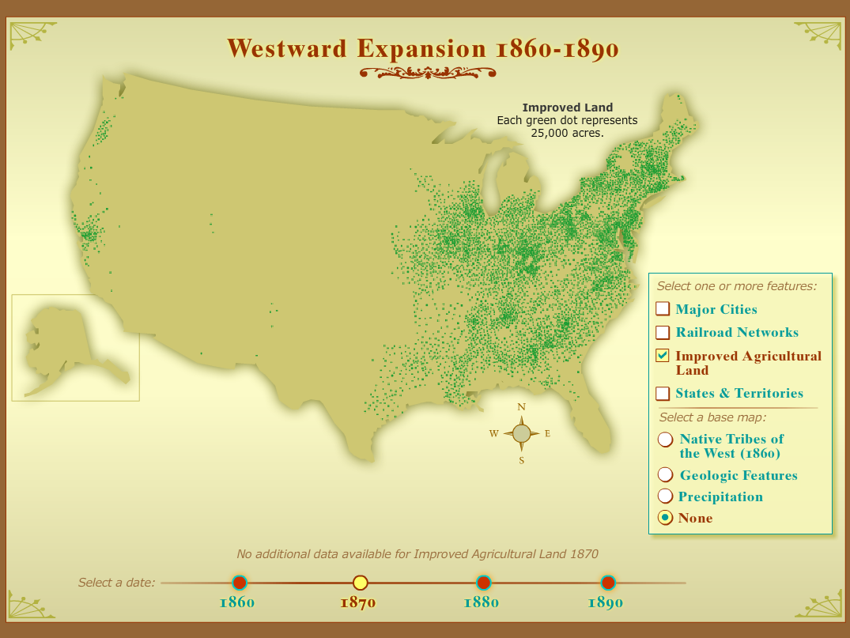
Agricultural Land - 1870

Slide 18
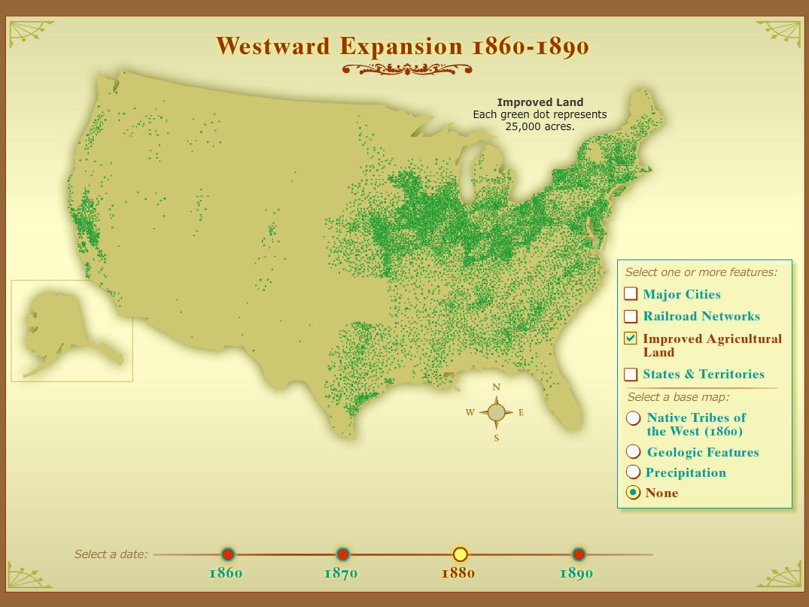
Agricultural Land - 1880

Slide 19
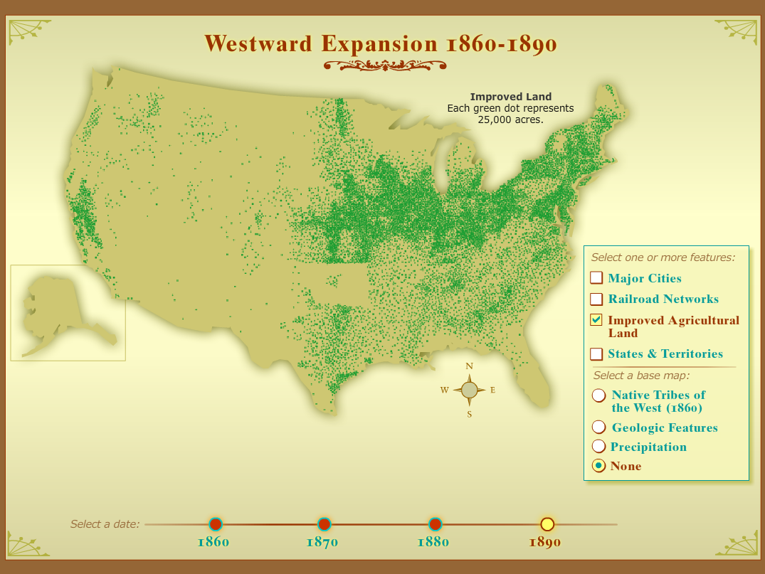
Agricultural Land - 1890

Slide 20
Cities, Railroads, Land and States combined
1860-1890 in ten-year intervals

Slide 21
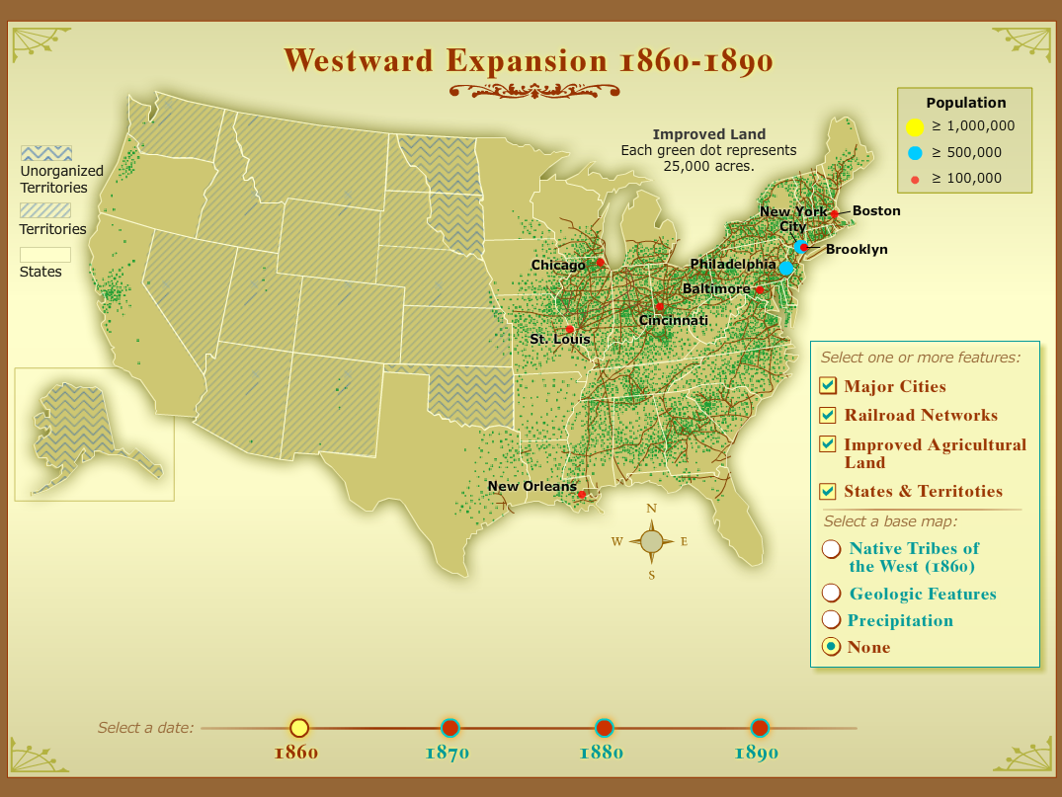
All features – 1860

Slide 22
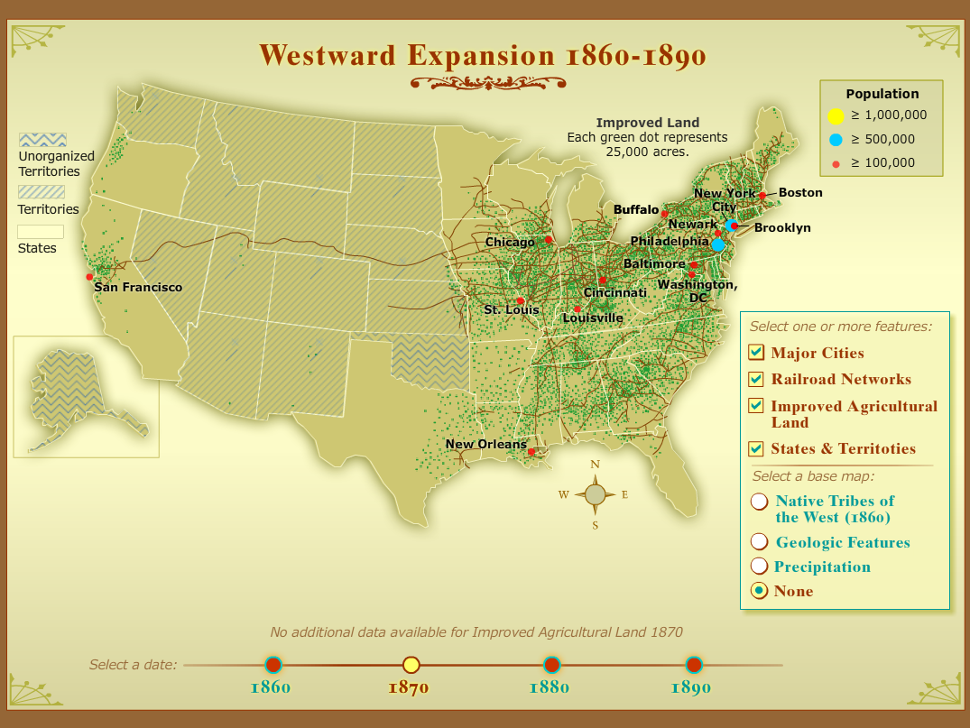
All features - 1870

Slide 23
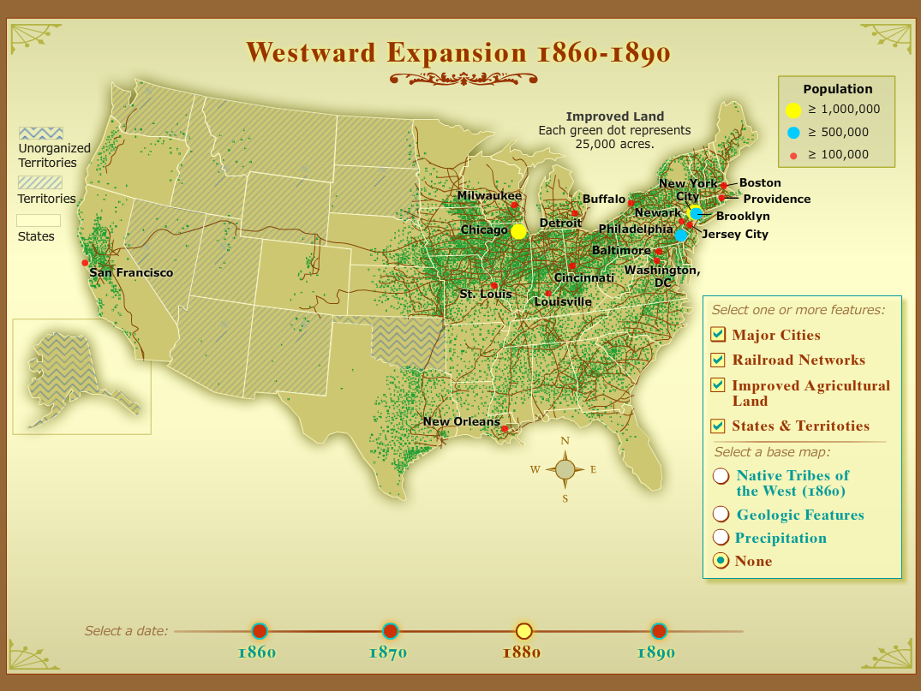
All features - 1880

Slide 24
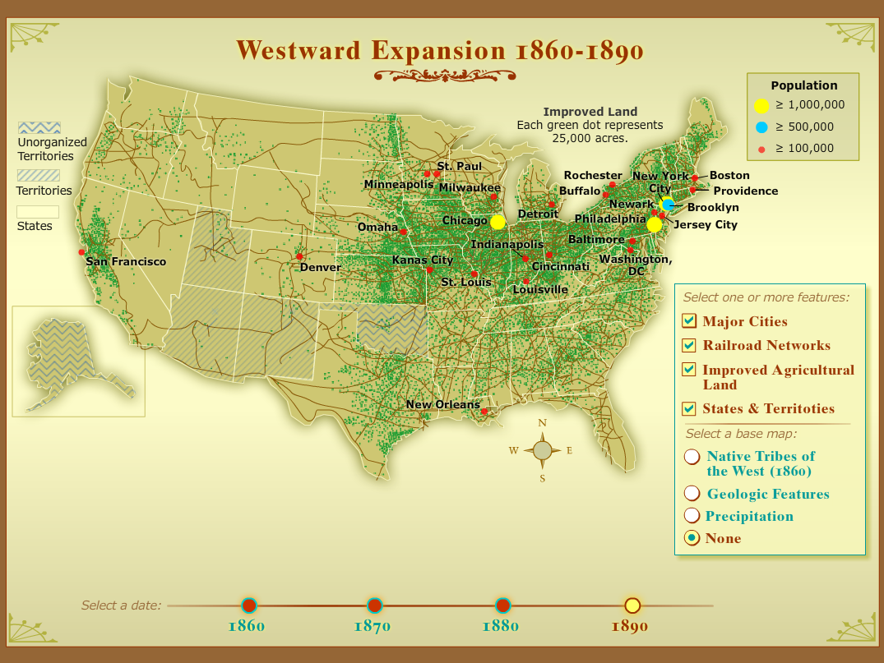
All features - 1890

